Slide 1
Impact of anti-inflammatory drugs on pain chronicity
14-09-2020

Slide 2
Previous meetings
First meeting
NSAID use during “acute” back pain seemed a predictor for chronification of this back pain in UK Biobank data
No adjustment for covariates
End of June
Adjusted for ethnicity, sex, age
Excluding individuals who said "prefer not to answer" to the question on number of drugs
No. of painful sites based on acute pain at v0 and not chronic pain at v0 as previously
Corticosteroids added as a covariate
Ajust for number of painful sites
Combination of v1 and v2 UKB

Slide 3
Previous meetings
Zoom meeting pharmacogenetics on different projects using medication and pain in UKB
Risk of confounding using NSAID vs no NSAID use
Try to use other ”negative” controls like Paracetamol, antidepressants etc
What happened with corticosteroids?
No predictor of chronicity in this population
Hypothesis: Corticosteroids > NSAIDs > paracetamol

Slide 4
Corticosteroids
Have to be systemic corticosteroids to expect an anti-inflammatory effect that could influence pain chronification

Slide 5
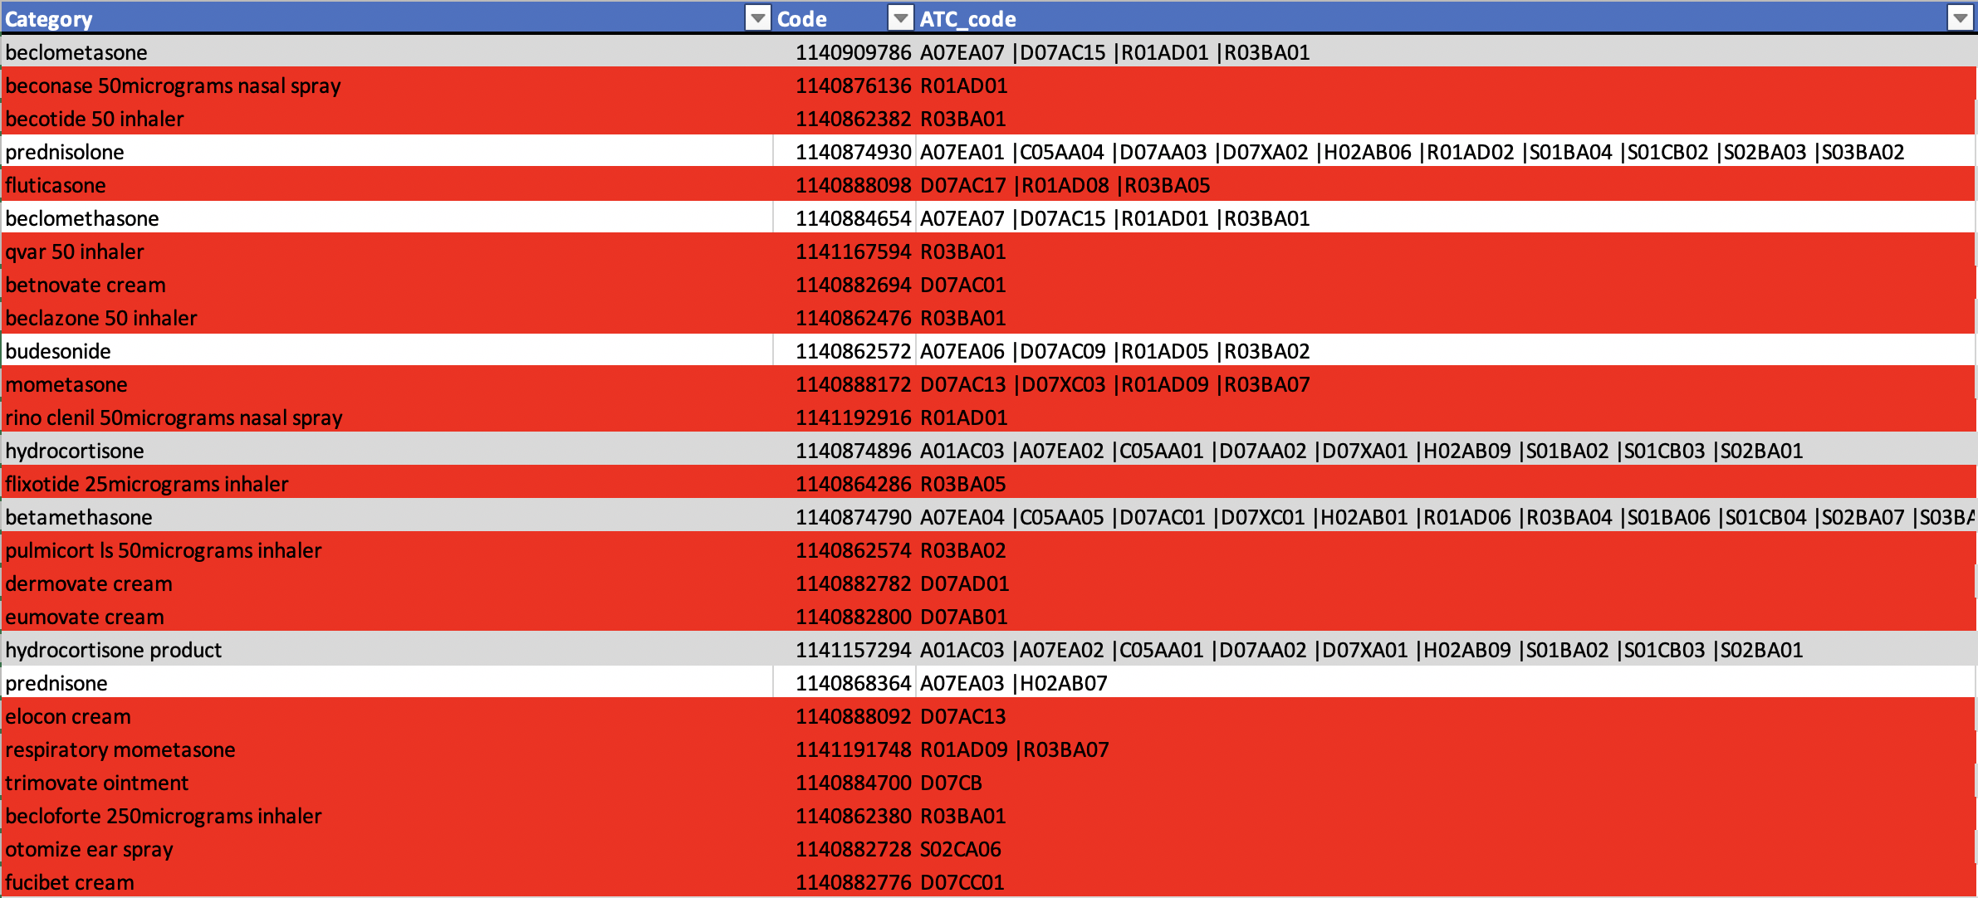
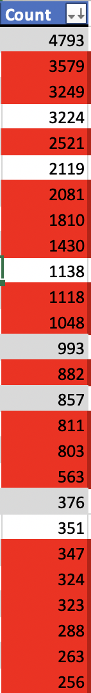
Corticosteroids

Slide 6
Corticosteroids
Remaining drug data is still ambiguous
Results in 7 patients that used possible systemic corticosteroids and developed chronic backpain

Slide 7
New analysis
Excluded corticosteroids
Conditional logistic regression for family relatedness in UKB
Paracetamol, opioids, antidepressants, pregabalin/gabapentin
Looked at time interval between visits in UKB
Excluded subjects > 1SD from the mean interval time

Slide 8
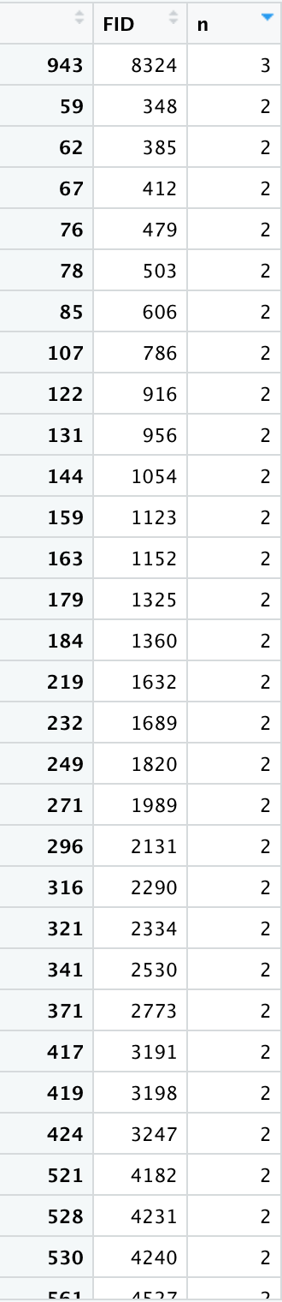
New analysis
Excluded corticosteroids
Conditional logistic regression for family relatedness in UKB
Paracetamol, opioids, antidepressants, pregabalin/gabapentin
Looked at time interval between visits in UKB
Excluded subjects > 1SD from the mean interval time

Slide 9
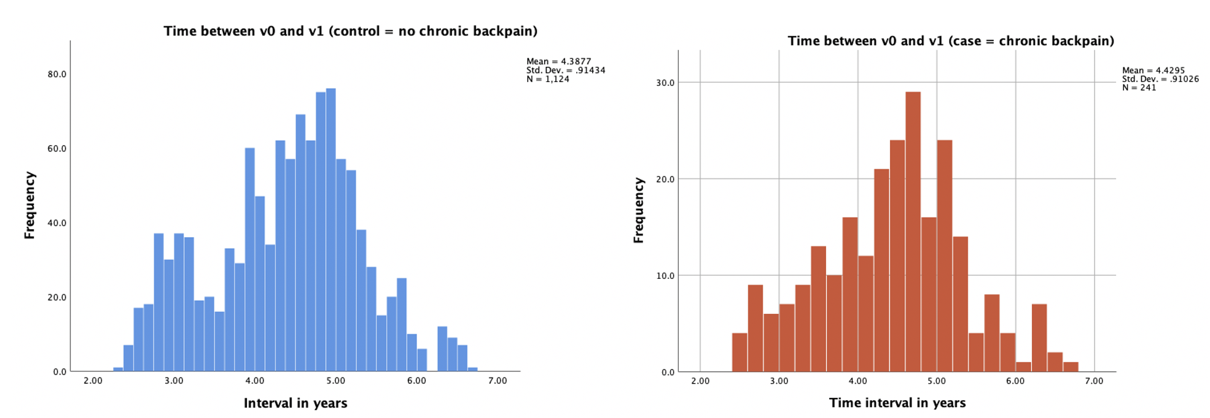
Time interval between visits

Slide 10
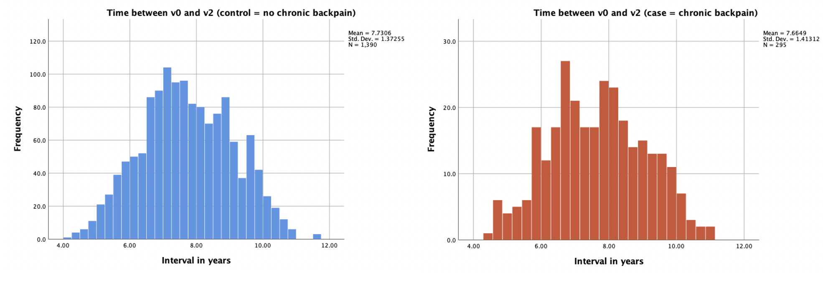
Time interval between visits

Slide 11
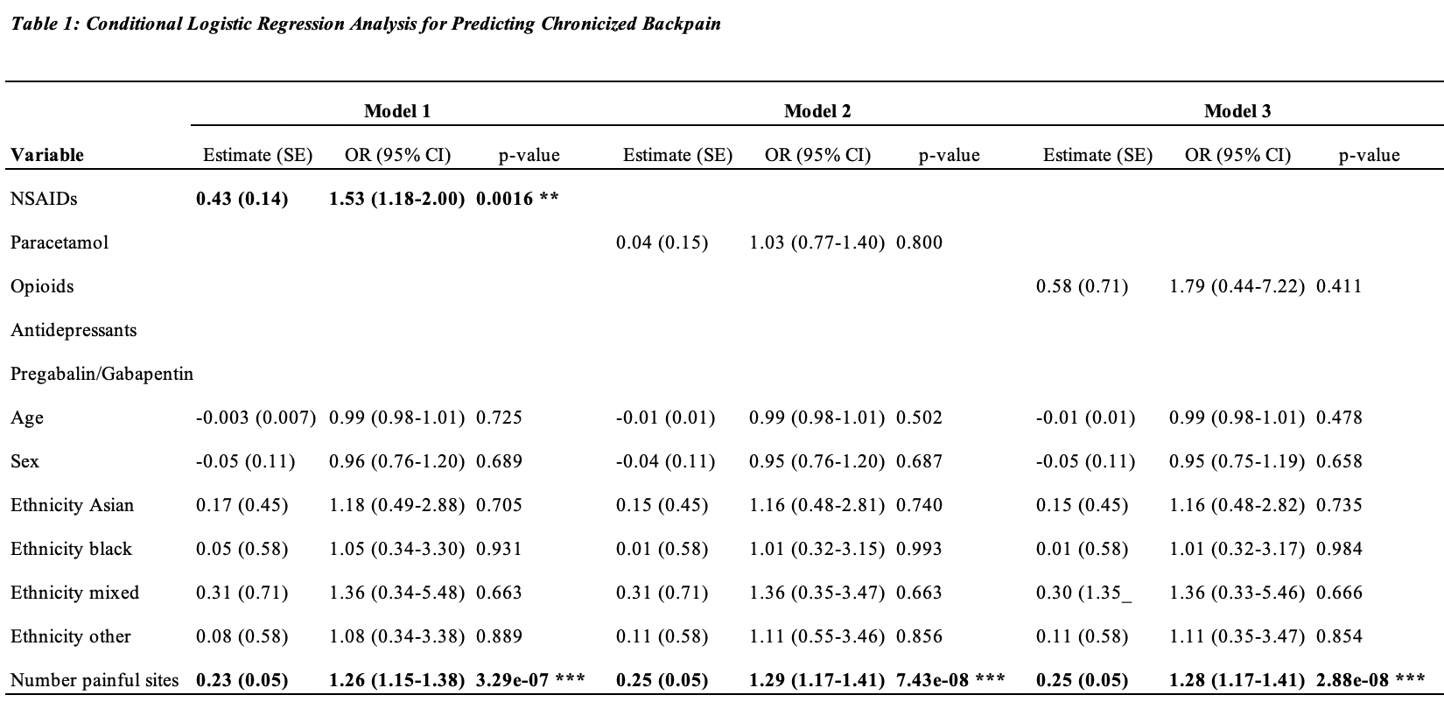
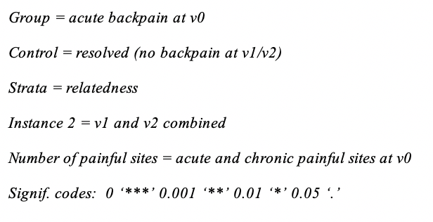

Slide 12
